Slide 1



HOUSEKEEPER SCHEDULING SYSTEM
Presented By Group-4

Slide 2

TEAM MEMBERS
1
Rutuja Devarakki
(TL)
2
Nandini R
Admin Login Module 01
Login to Portal.
Create Admin Account.
Allot Housekeeper Module 02
Admin will select a housekeeper and allots a housekeeper with a specific request coming from a student.
ADMIN
Register Housekeeper Module 03
Admin can Add housekeeper details like name, hostel, floor, rooms.
3
Priyanshu
4
Swetha M K
Feedback & Request Module 04
Maintain the feedback and request status of the user.

Slide 3
TEAM MEMBERS
1
Shivam
Singh
2
S Dinesh Kumar
User Login Module 01
Register & Sign into the application to maintain the record of activities.
Update User Profile Module 02
Change Password & Update Profile.
USER
User Cleaning Request Module 03
User can send a room cleaning request to the admin and admin should allot a housekeeper to the user.
4
Sweety
Janet
3
Debasrit Behera
User Feedback Module 04
User can send the feedback of housekeeping and admin should close the request.

Slide 4

Content
01
Abstract
02
Objective
03
Project Architecture
04
Tools & Technologies
05
Advantages
06
Conclusion
07
Screenshots

Slide 5


ABSTRACT
The main objective of HOUSEKEEPER SHEDULING SYSTEM is hostel students can use to get their rooms cleaned on time.
Admin will select a housekeeper.
Using this HOUSEKEEPER SHEDULING SYSTEM Admin can Add details.
By using HOUSEKEEPER SHEDULING SYSTEM we can maintain the feedback and request status of the user.

Slide 6
OBJECTIVE
The function will automatically generate cleaning plans.
The housekeeping department takes pride in keeping the hostel clean and comfortable.
Housekeeper to perform cleanliness duties most efficiently and effectively.

Slide 7
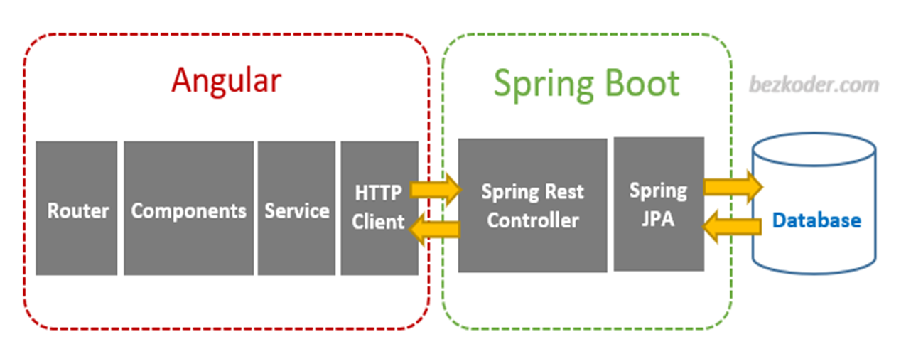
PROJECT ARCHITECTURE

Slide 8
TOOLS & TECHNOLOGIES
Front-End : Angular
Server-side : Spring Boot
Back-end : MYSQL,
Hibernate
Testing: Postman, JUnit

Slide 9
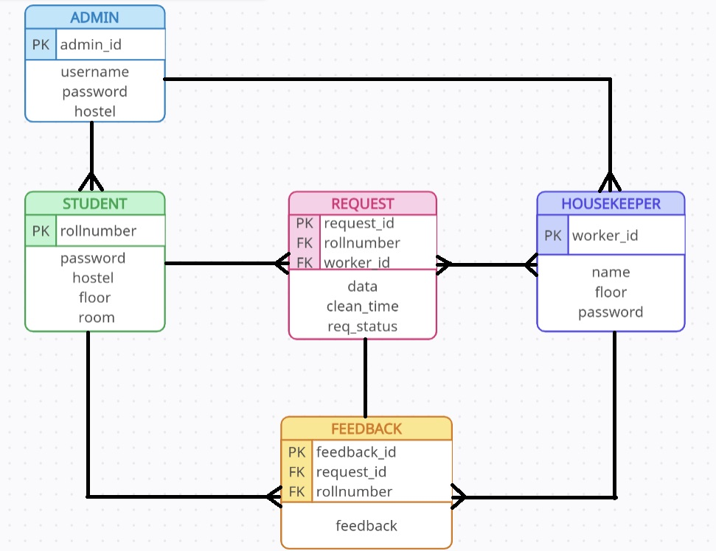
ER DIAGRAM

Slide 10
MODULES
Admin Module:
Register: Admin can create his personal account.
Login: Admin can login to his account.
Allot: Admin can allot a housekeeper.
Housekeeper Registration: Admin can select a housekeeper and can add housekeeper details.
Feedback: Admin will maintain feedback and request of students.
Register Student: Admin can register a new student.
Register Housekeeper: Admin can register a new housekeeper.
Logout: Admin can logout after the completion of his work.

Slide 11
MODULES
User Module:
Register and Login: User can create his account and can login to his account.
Dashboard: Where all the details are displayed.
Requests: User can request a housekeeper by selecting date and time.
Feedback: User gives the feedback like suggestions and complaints about the housekeeper performance.
Profile: Details of the User.
Password: User can update his password.
Logout: User can logout after the completion of his work.

Slide 12
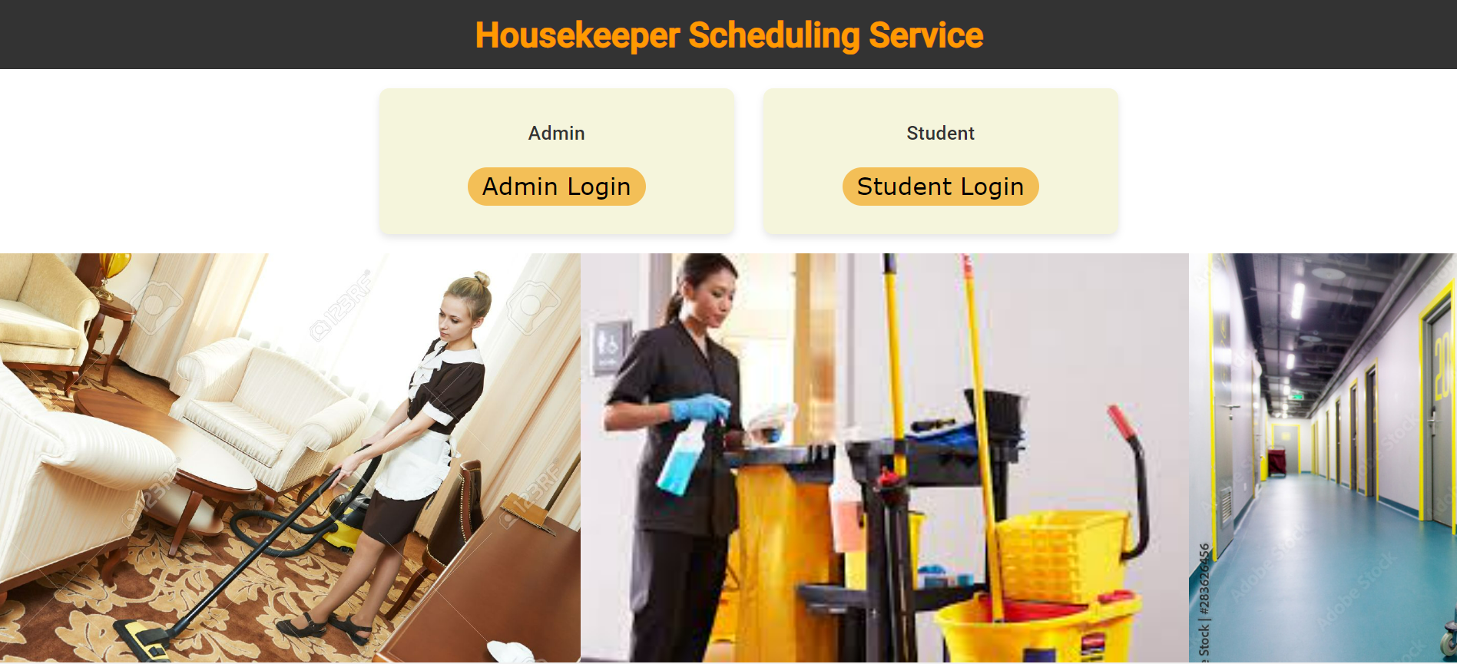
HOME PAGE

Slide 13

ADMIN LOGIN

Slide 14

ADMIN REGISTRATION

Slide 15
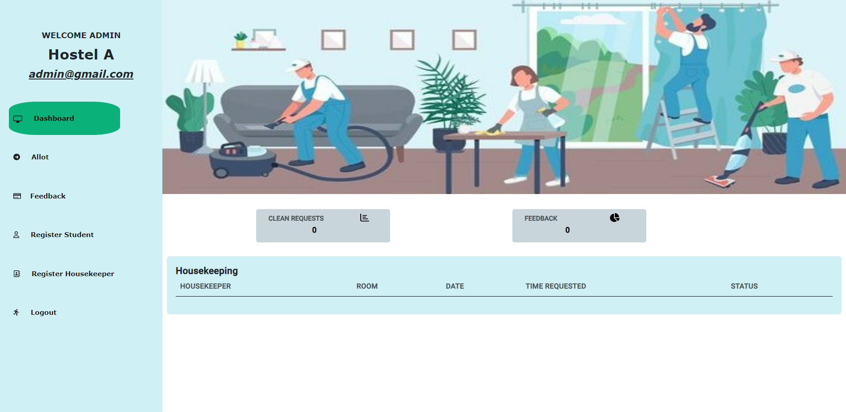
ADMIN DASHBOARD

Slide 16
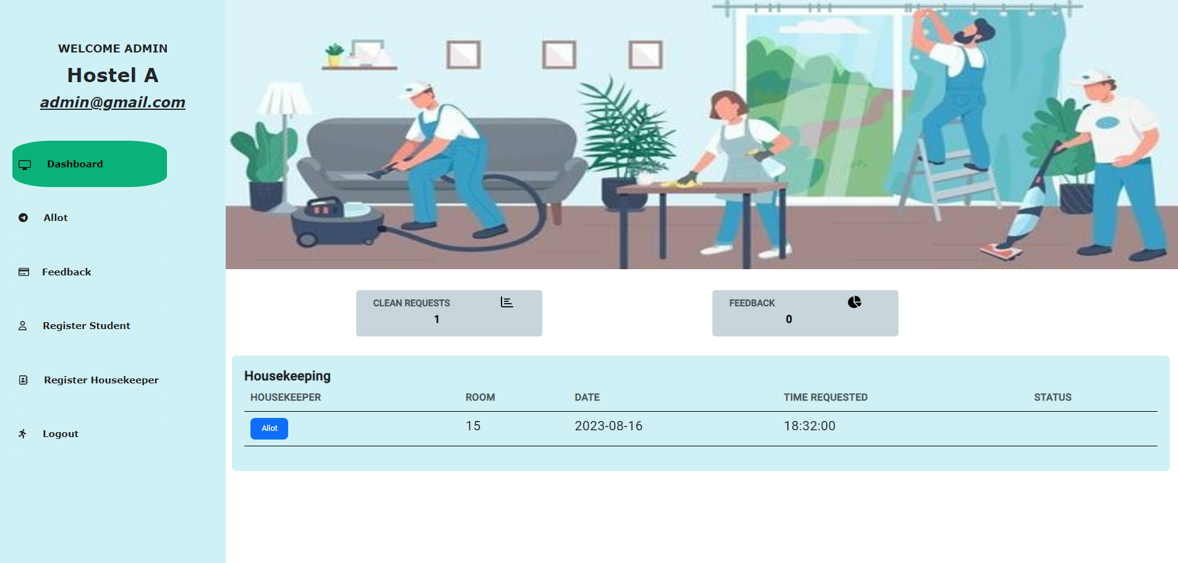
ALLOT HOUSEKEEPER

Slide 17
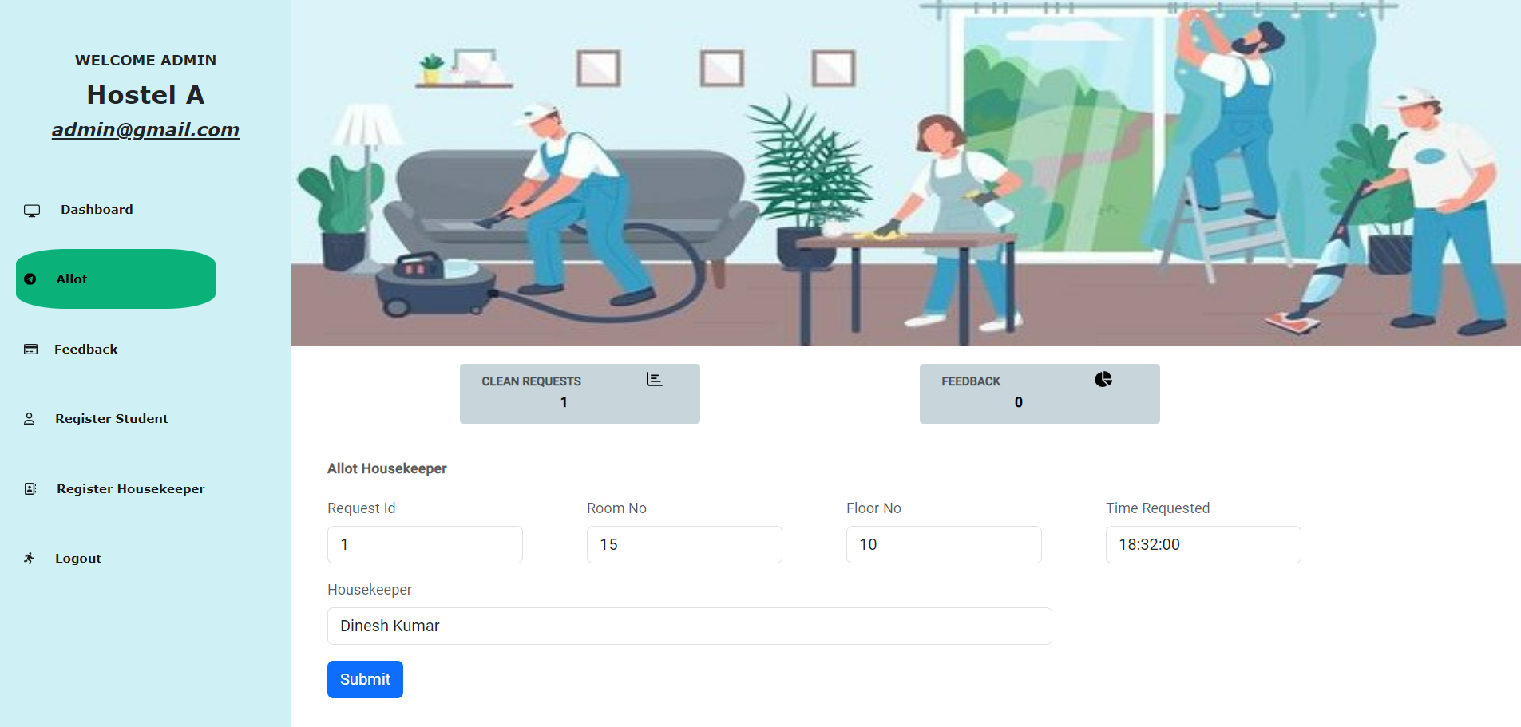
ALLOT PAGE

Slide 18
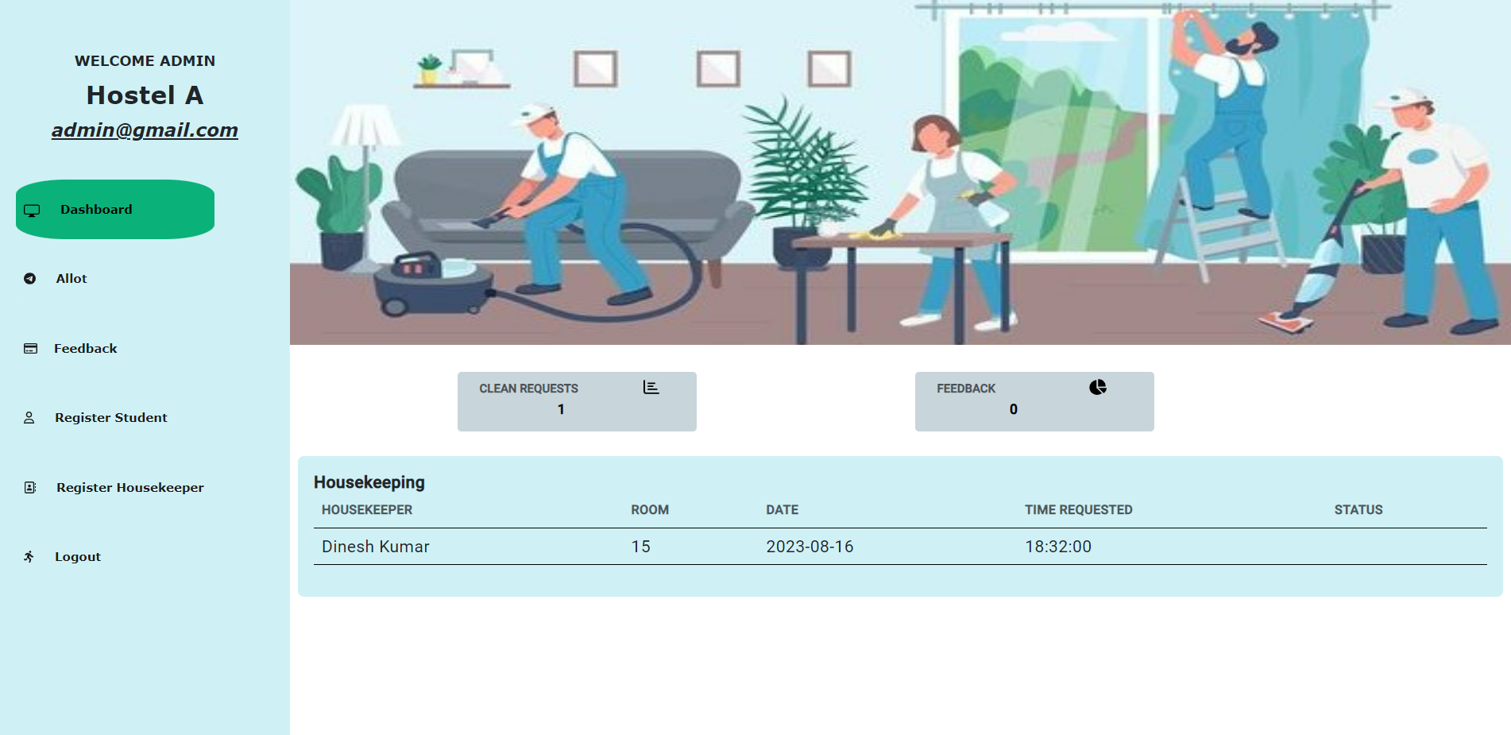
DASHBOARD AFTER ALLOT

Slide 19
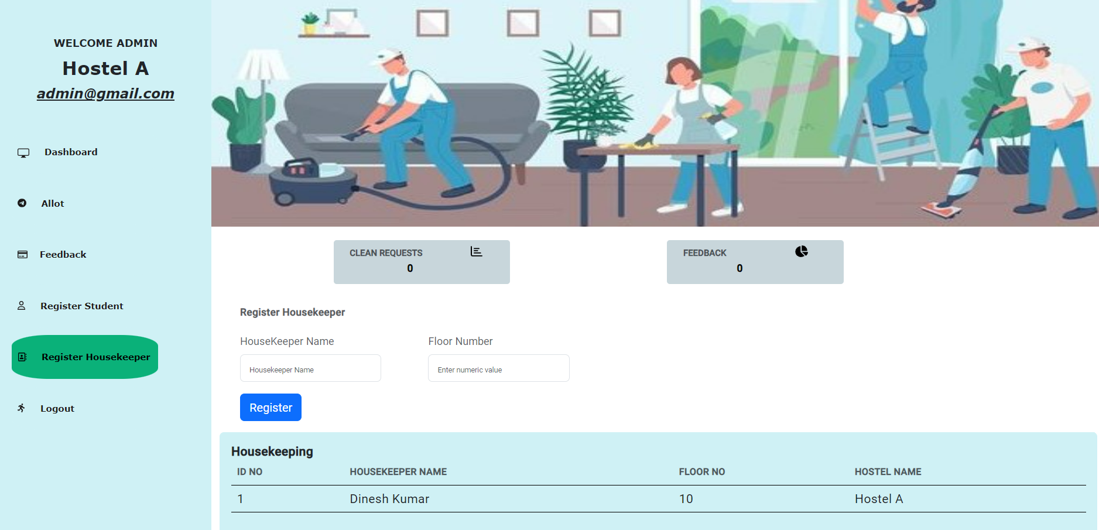
REGISTER HOUSEKEEPER

Slide 20
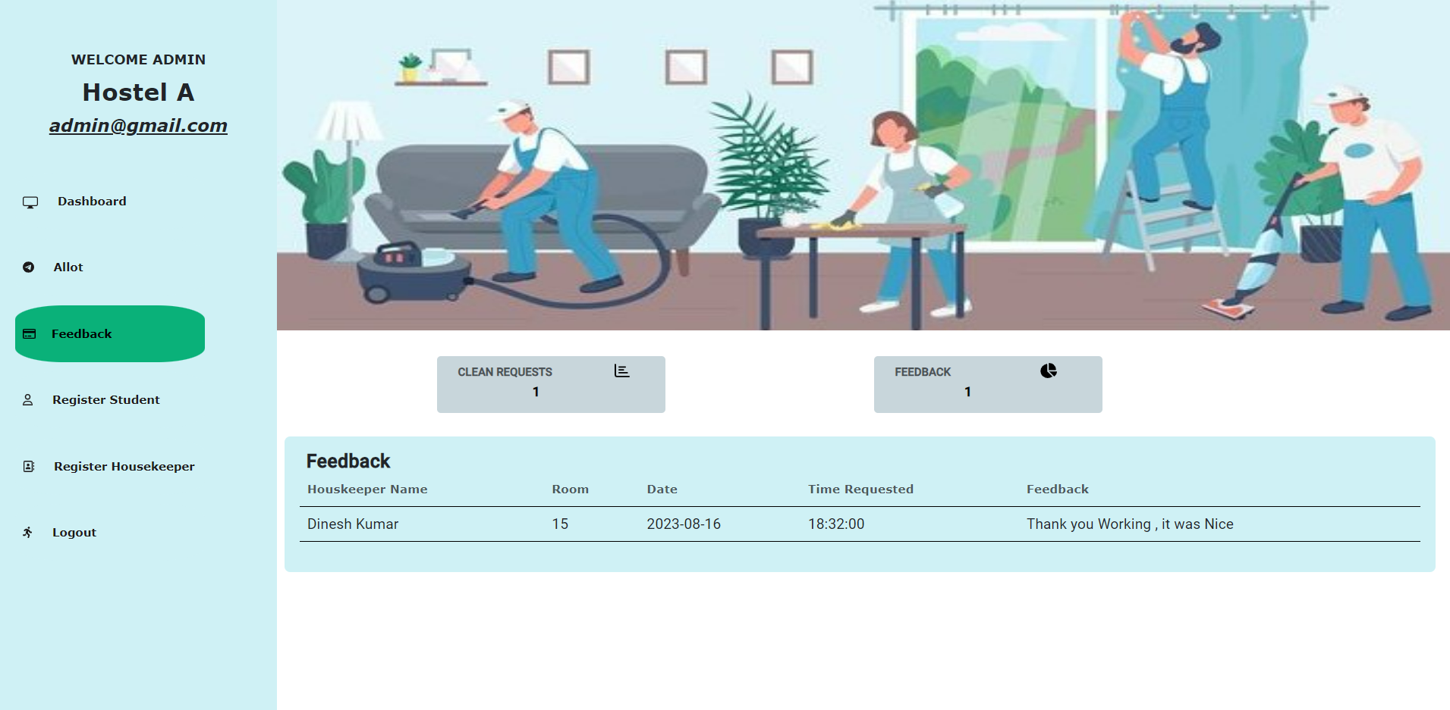
FEEDBACK

Slide 21

DASHBOARD AFTER FEEDBACK

Slide 22

USER LOGIN

Slide 23

USER REGISTER

Slide 24
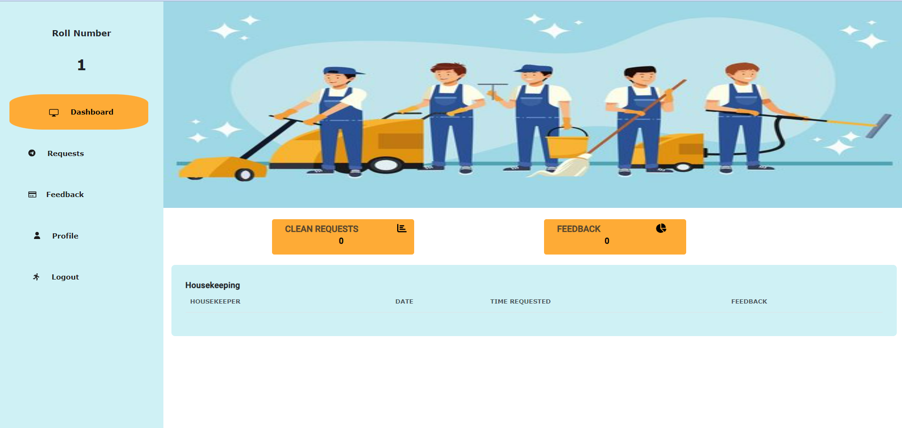
USER DASHBOARD

Slide 25
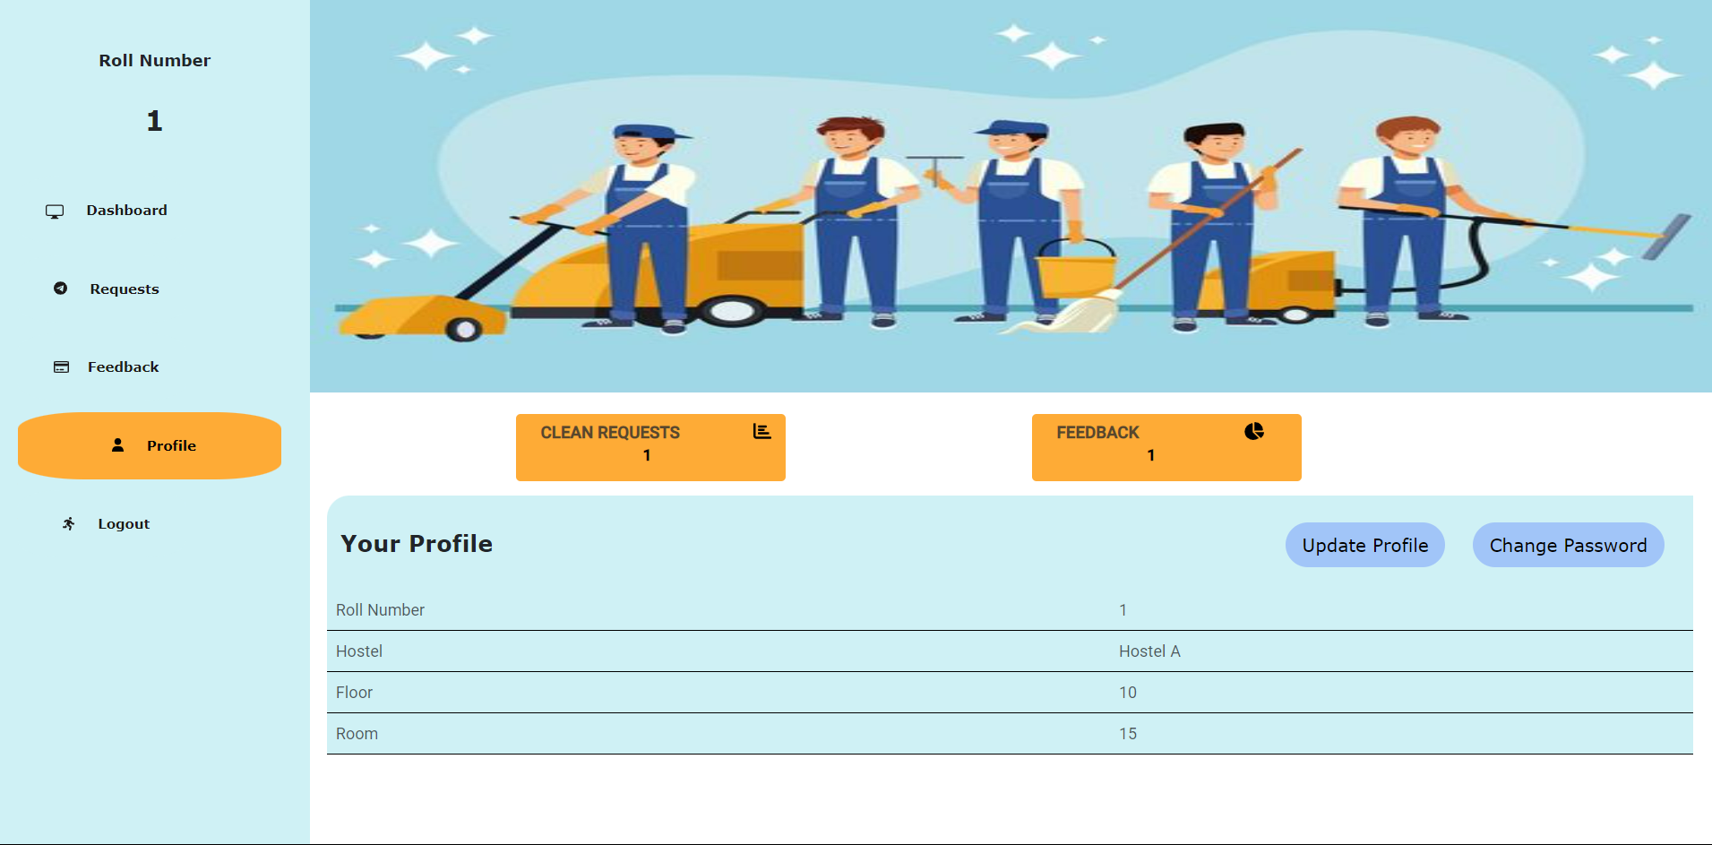
PROFILE PAGE

Slide 26
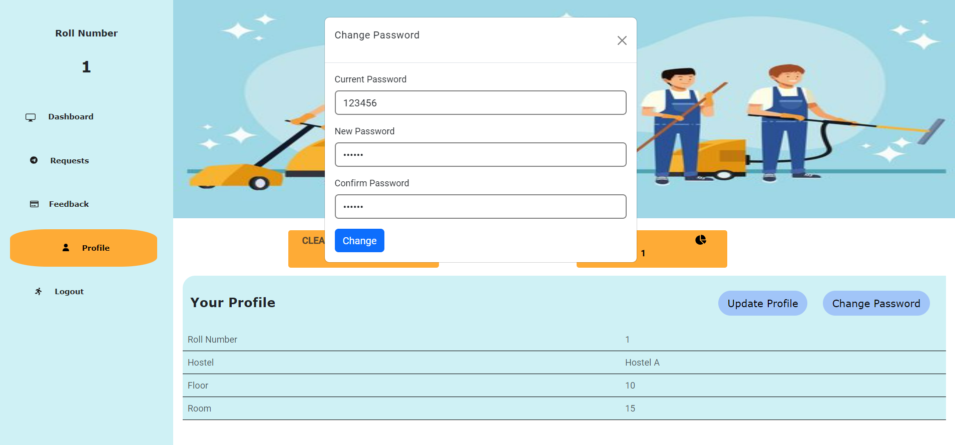
CHANGE PASSWORD

Slide 27
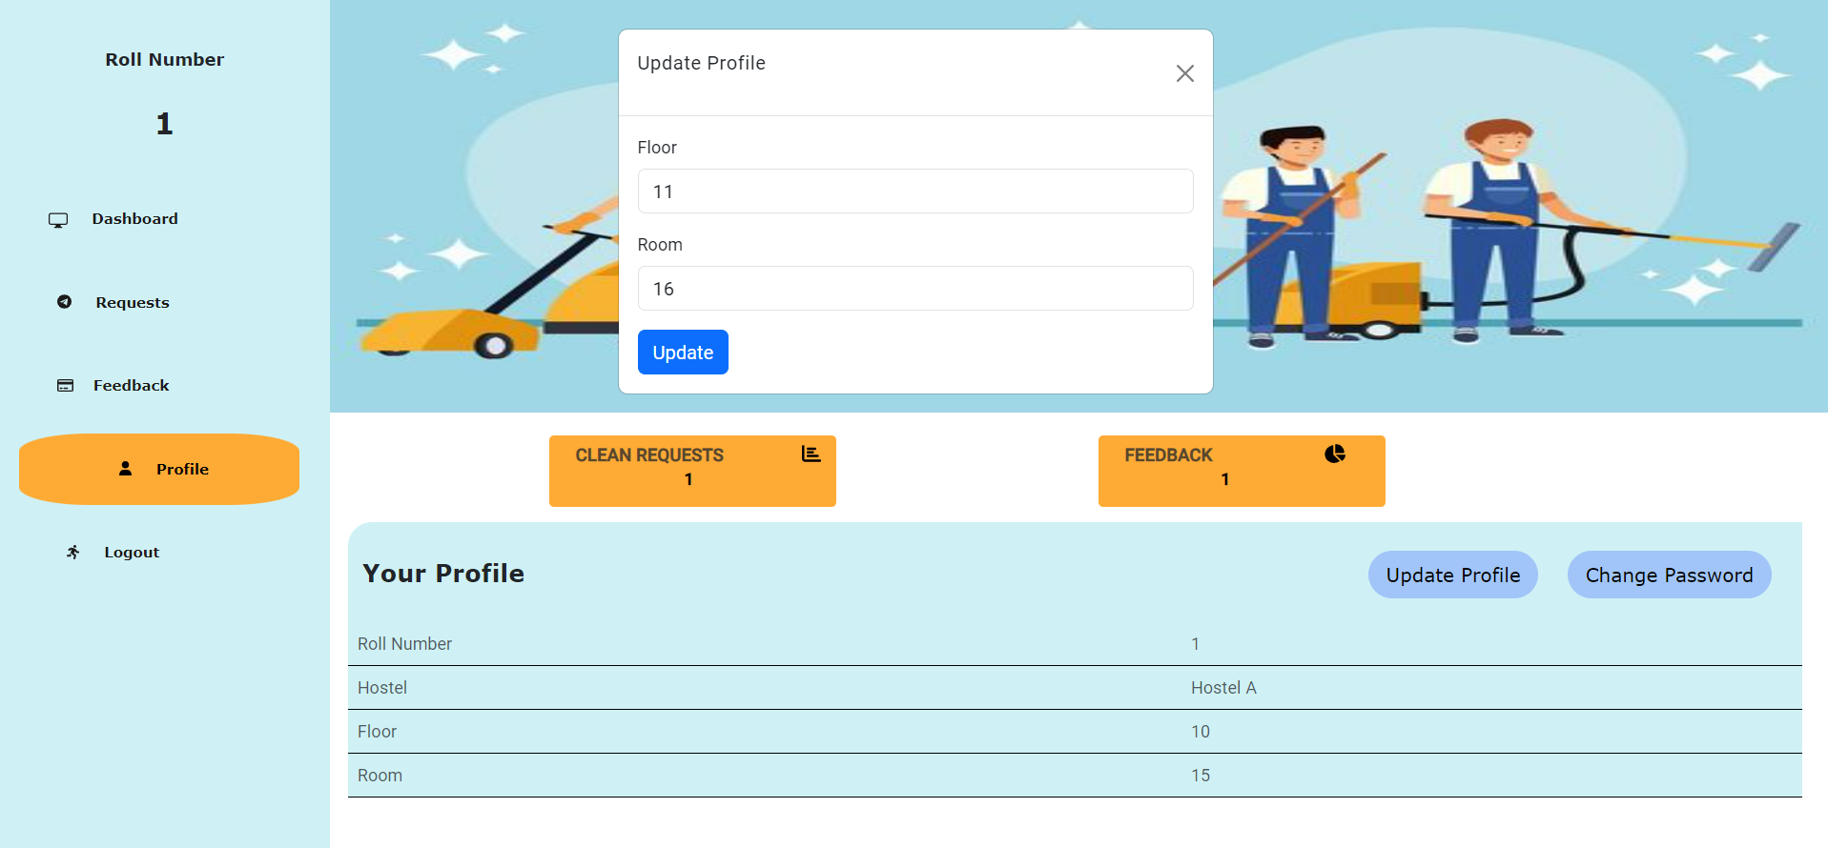
UPDATE PROFILE

Slide 28
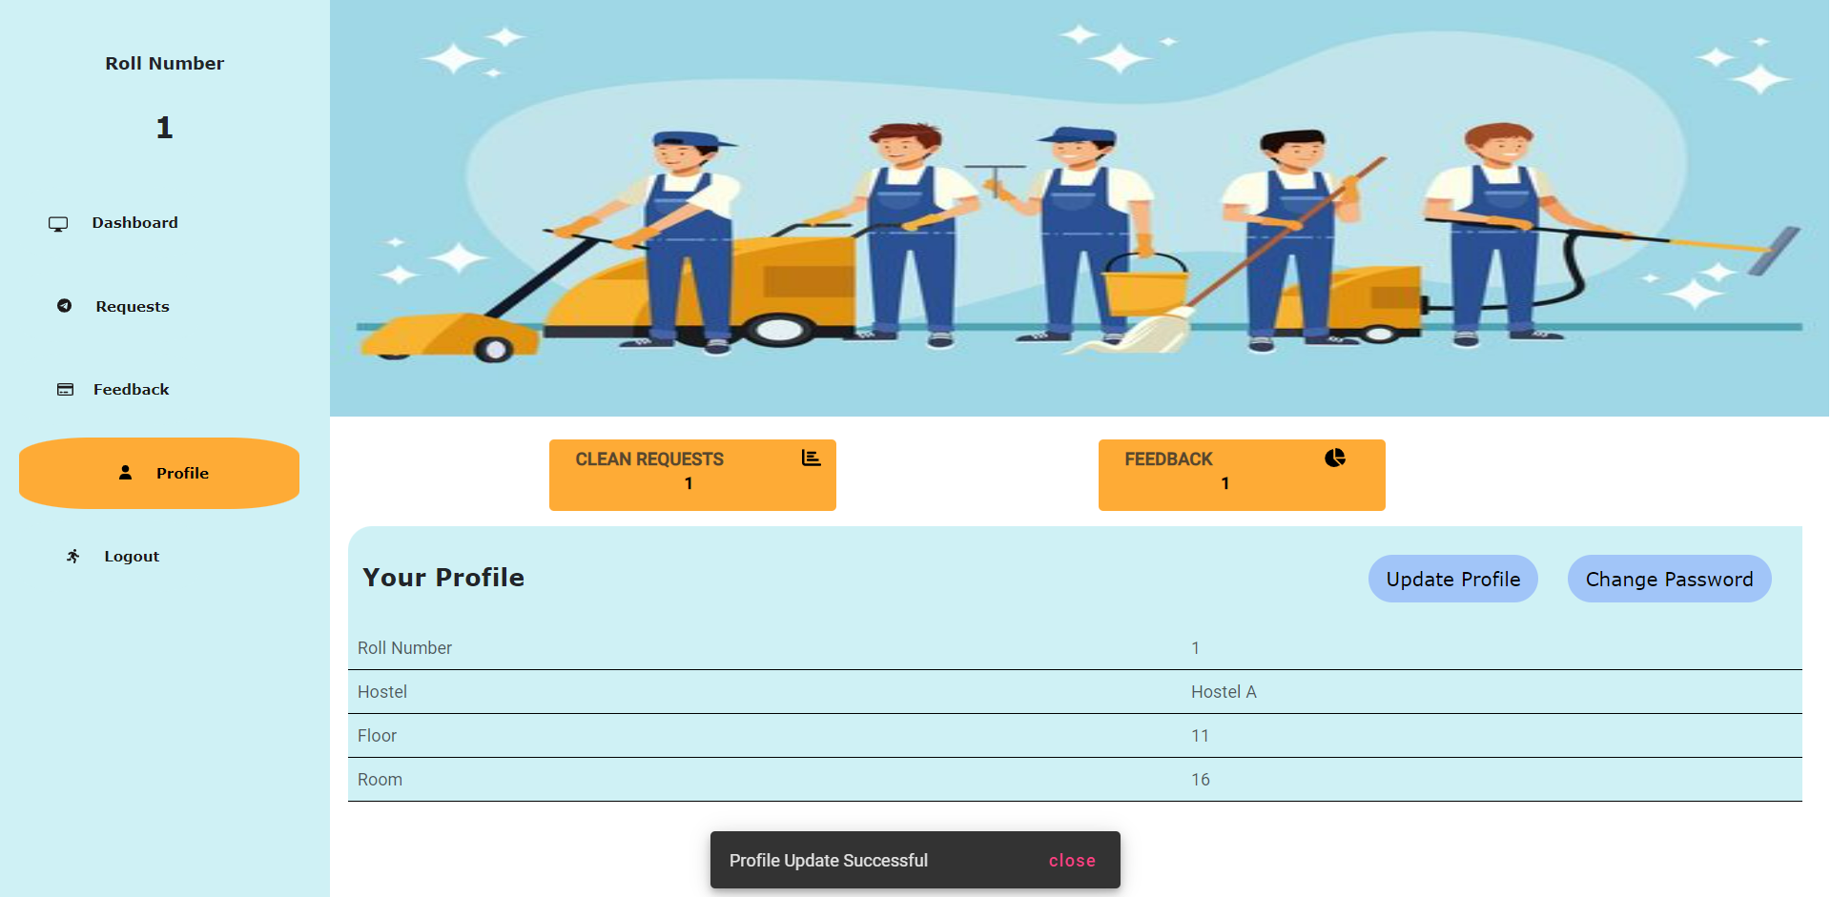
UPDATED PROFILE

Slide 29
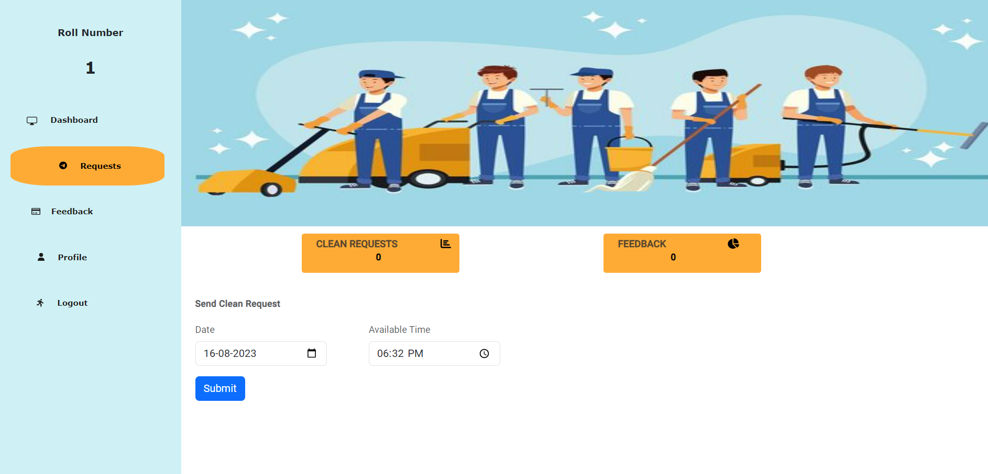
REQUEST HOUSEKEEPER

Slide 30

DASHBOARD AFTER REQUEST

Slide 31
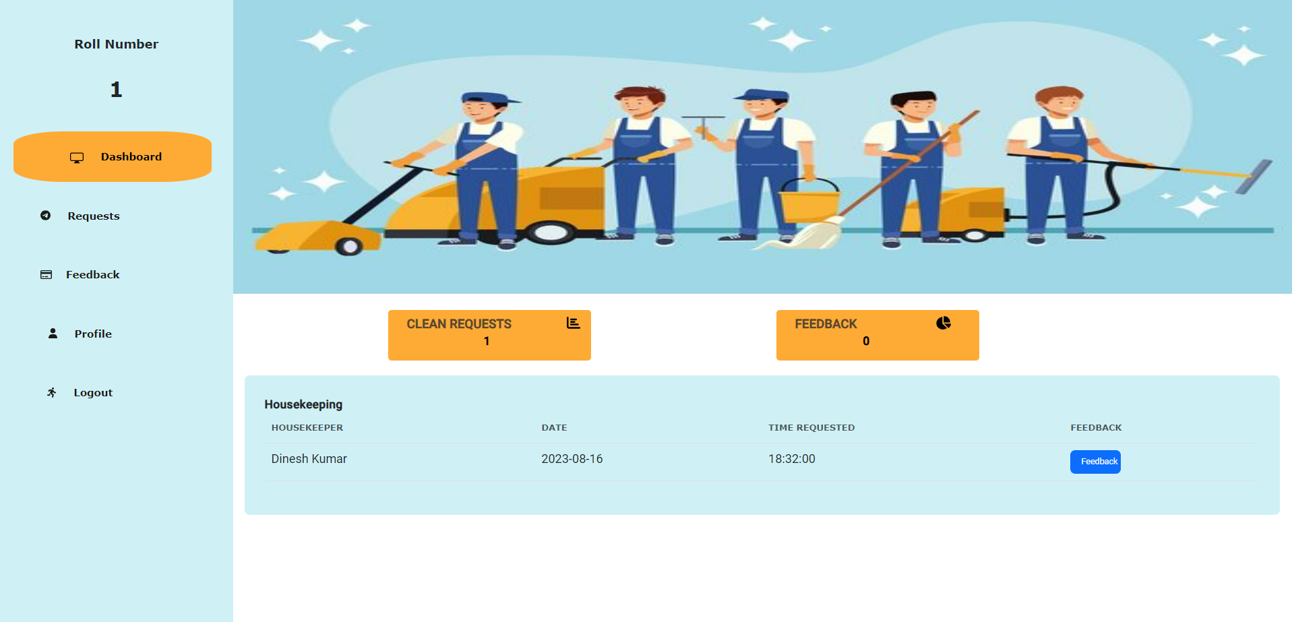
DASHBOARD AFTER ALLOT

Slide 32
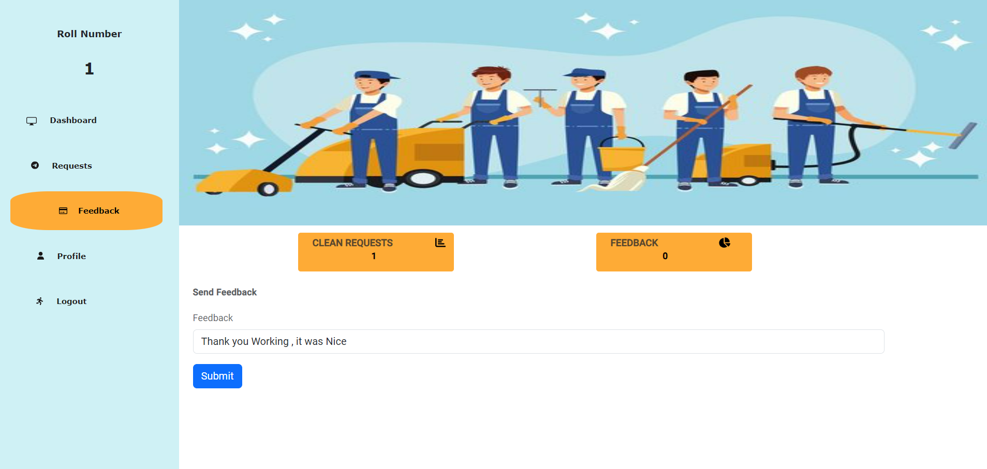
FEEDBACK PAGE

Slide 33

DASHBOARD AFTER FEEDBACK

Slide 34
ADVANTAGES
This system is very easy to understand and user friendly.
Student and Housekeeper are connected with each other on one system.
This system is saving the time for student and hostel warden too.
In this system user can connect any time whenever he/she wants.
This system is secure.

Slide 35
CONCLUSION
The Housekeeper Scheduling System is a fundamental tool that significantly enhances the cleaning process in student hostels.
With its user-friendly interface, this system enables hostel administrators to easily allocate housekeeping tasks, effectively coordinate schedules, and closely monitor room cleaning activities.
Lastly, students benefit from a cleaner and healthier living environment. A well-maintained hostel fosters a positive atmosphere, contributing to their overall well-being and academic success.

Slide 36

THANK YOU

